Slide 1
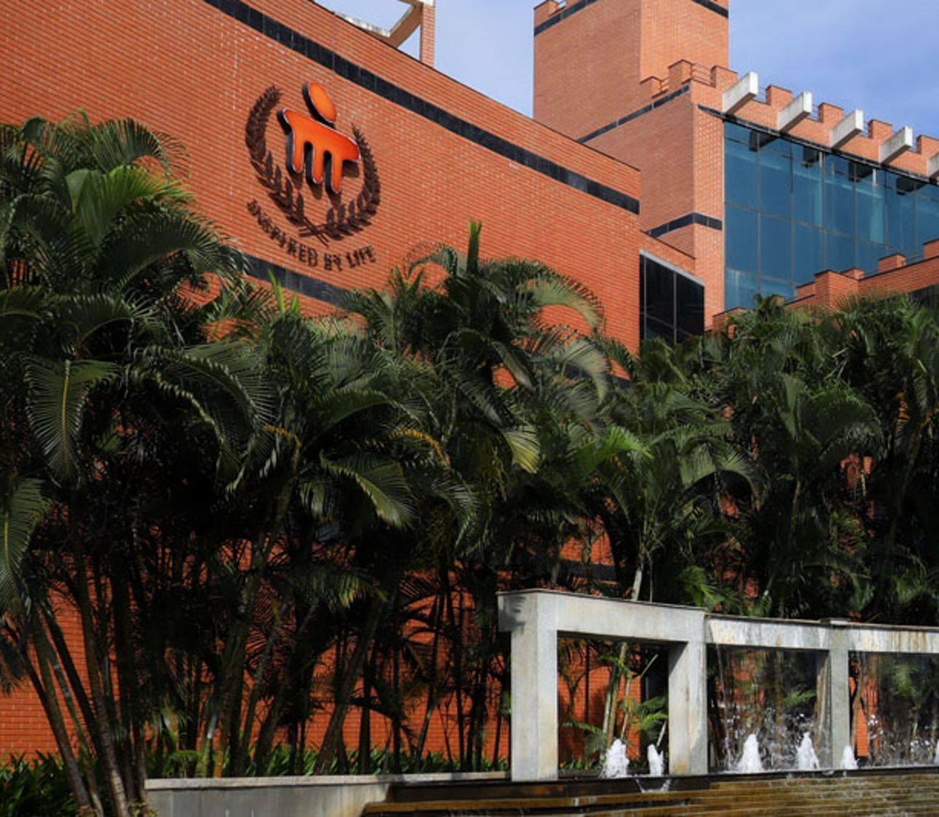
BETTER PRICING SOLUTION FOR FARMERS
TEAM DEAL: -S JAIADITYAN -P SREE NEHA from -amrita school of engineering, Chennai.

Slide 2
Index
01
02
03
04
Relevance to the theme
Uniqueness of the idea
Feasibility of the solution
Technology used
05
Marketing /media ideas.

Slide 3

01
Relevance to the theme

Slide 4


Problem statement :
As stress on Indian agriculture increases because of
the continuous fragmentation of landholdings and climate change, there is a serious threat to livelihood based on farming.
A major reason for MSP was to prevent distressed sales by farmers and procurement for food security as well as to protect against excessive falls in prices during bumper production years.
But there are some constraints like not being legally enforced: the Stagnant rates:
Lack of awareness:
Unequal access:
Price fixing by a handful of middlemen cartels etc.
There is a need for fair pricing of farm products at local as well as national levels to decrease cases of hoarding and involvement of middlemen as well as increase its reach to everyone.

Slide 5
Solution and relevance to the theme:
01
1. Farmers -> retailers -> customers (surety)
2. Farmer -> warehouse -> customer (good quality)
3. Farmer -> customer (low price)
In every chain, the farmer gets a profit of at least 10%
This would be done directly via an app.
💡This is the solution for the problem statement

Slide 6

02
Uniqueness of the idea

Slide 7
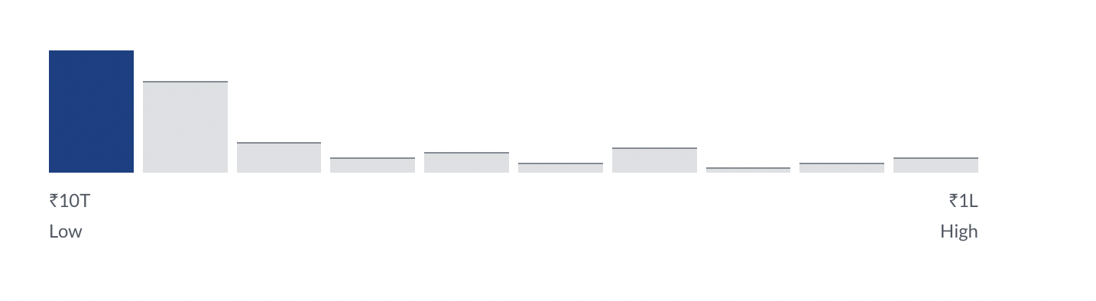
Is our idea unique ?
Present scenario: Farmers will soon get an app to track warehouses to store produce & avoid crops going to waste
₹20,851 /month
Average Base Pay
31 salaries
₹10T
Low
₹1L
High
Additional Cash Compensation
Average: ₹3,89,054Range: ₹12,193 - ₹7,65,915
How much does a Farmer make? The national average salary for a Farmer is ₹20,851 in India. Filter by location to see Farmer salaries in your area. Salary estimates are based on 31 salaries submitted anonymously to Glassdoor by Farmer employees.
How much does a farmer make?

Slide 8
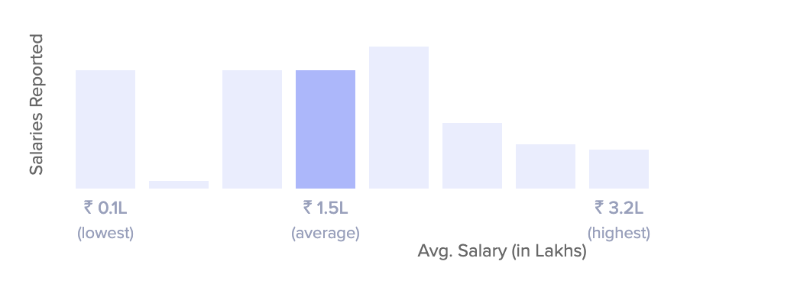
Is our idea unique ?
Estimated Take Home Salary
₹ 10,513 - ₹ 11,665/month
Average Annual Salary
₹ 1.6 LPA
₹0.1L
Low
₹4.0L
High
How much does a retailer make? Retailer salary in India ranges between ₹ 0.1 Lakhs to ₹ 4.0 Lakhs with an average annual salary of ₹ 1.6 Lakhs. Salary estimates are based on 612 salaries received from Retailers.
How much does a retailer own?

Slide 9
Is our idea unique ?
Our idea :
Betterment of this solution is our idea which isn’t thought yet makes our idea more unique. We are going to create an app where it connects
1. Farmers -> retailers -> customers (surety)
2. Farmer -> warehouse -> customer (good quality)
3. Farmer -> customer (low price)
It is profitable for all the three connections for farmer present in the chain.
💭This is something out of the box

Slide 10
03
Feasibility of the solution

Slide 11
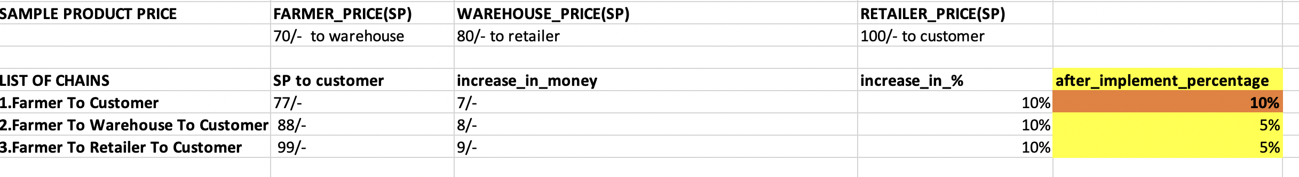
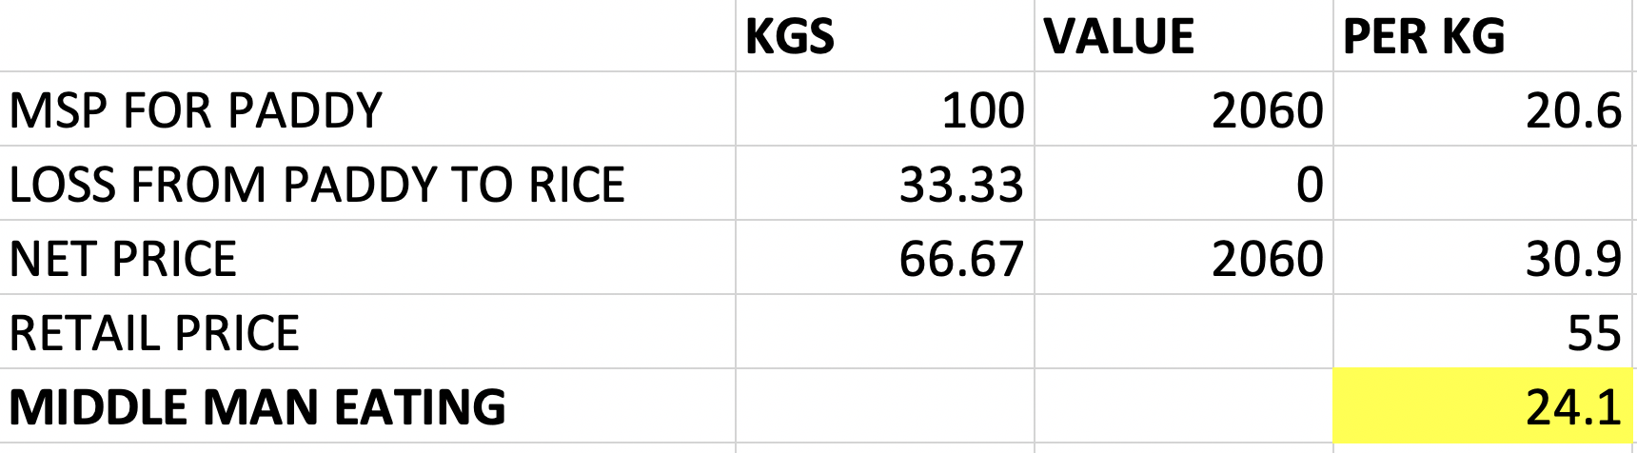
Is our solution feasible ?
The practicality of the solution:
MIDDLE MAN EATING:

Slide 12

Is our solution feasible ?
Direct connection between farmer and consumer will give low cost for consumer and better profit to the farmer but there are no one to assure the quality.(BC)
Connection without the warehouse will remove the middlemen who is consuming the profit and the retailer but the storage , potential for increased cost and lower sales volume in a particular location might happen.(BBC)
Connection without retailer will increase the profit of the farmer and the warehouse person, this has been implemented in other sector and is working successfully. Example : AMAZON.(BBC)
It is Profitable Isn’t it?
Will the project be able to reach the point of practical implementation?
Yes.✅
The practicality of the solution:
There are three major ways
to connect a farmer and a consumer. It has its own pros and cons

Slide 13
Is our solution feasible?🤔
Here are some pros and cons of e-commerce for Ag business:
Disadvantages :
Promotion-Attracting Customers.
Customer Connections and Experience
Time requirement
Technical management and support
consumer product Uncertainty
Product Compatibility
Packaging and distribution
Advantages :
Market Outlet Diversification
Product details and suggestions
Expanded customer base
Customer convenience
Data

Slide 14
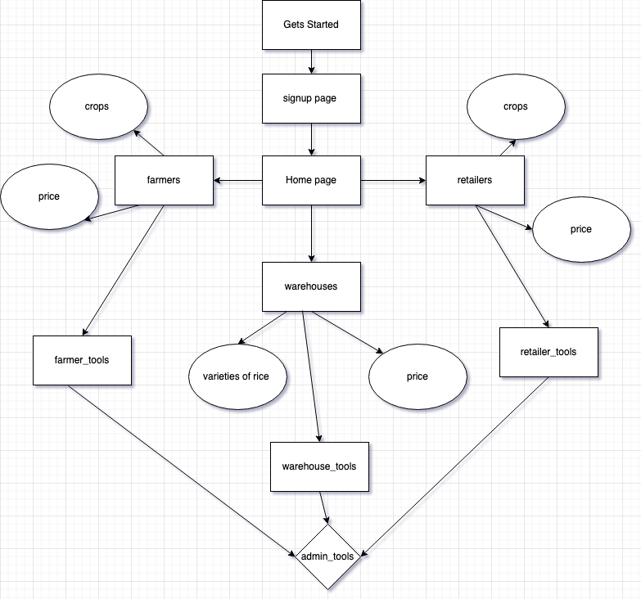
➡️ Detailed flowchart

Slide 15
➡️ UI FOR APP

Slide 16
04
Technology used

Slide 17
Technology used:
Flutter – App Development
Firebase – Authentication and data handling
R – data visualization
Figma software – UI
Google cloud - CL/CI

Slide 18
05
Marketing/ media ideas

Slide 19
Marketing/media ideas:
02
01
It will be started implemented in the real world by either 3 ways:
Selling to government
Start up
Working with government
Low prices -
This attracts people to use our product isn’t it?
Make use of google my business.
03
Google ads, Facebook ads, social media post

